Slide 1



Multiplayer Kubernetes:
GitOps with Friends

Slide 2






Yash Sharma
LFX mentee at
layer5.io/community/members/yash-sharma
@yashsharma_f
github.com/Yashsharma1911

Slide 3

Cloud Native Management

Slide 4


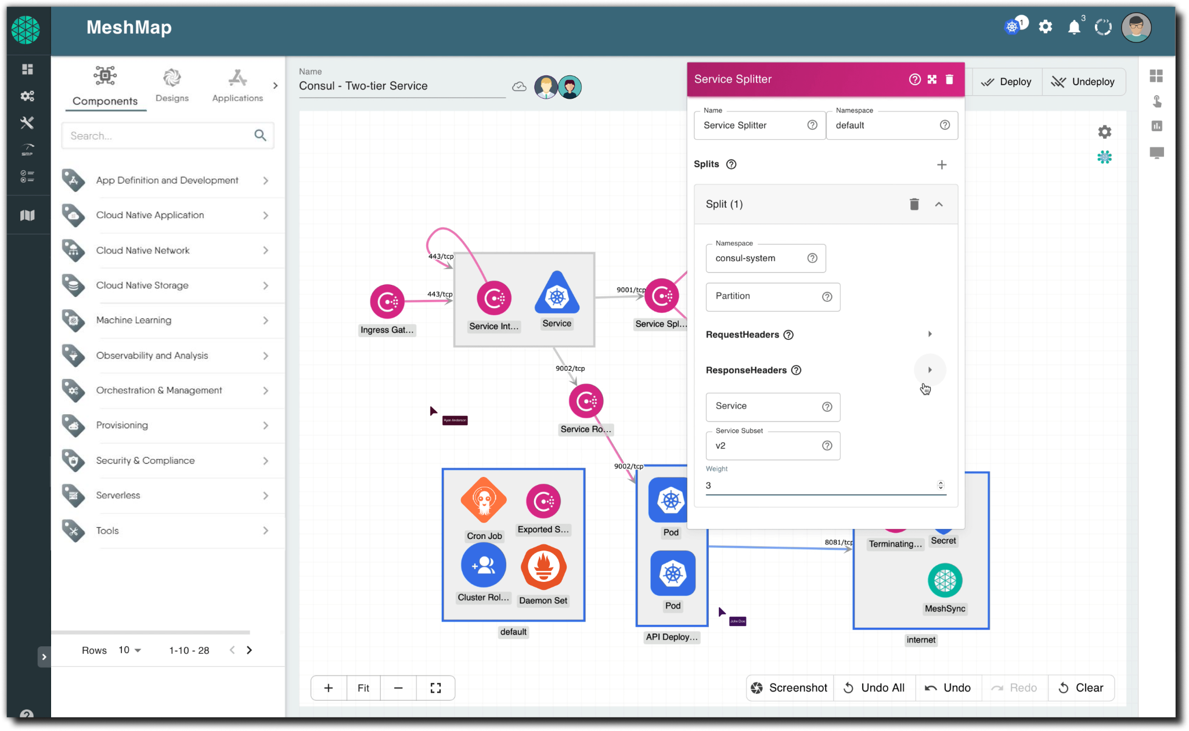
The cloud native management platform
Meshery
✔︎ Visually and collaboractively manage your
infrastructure

Slide 5
The cloud native management platform
Meshery
✔︎ Visually and collaboractively manage your
infrastructure
✔︎ Multi-cluster management for Kubernetes
and Clouds

Slide 6
The cloud native management platform
Meshery
✔︎ Visually and collaboractively manage your
infrastructure
✔︎ Multi-cluster management for Kubernetes
and Clouds
✔︎ Context-Aware Policies For Designs
Backed by OPA evaluation

Slide 7
The cloud native management platform
Meshery
✔︎ Visually and collaboractively manage your
infrastructure
✔︎ Multi-cluster management for Kubernetes
and Clouds
✔︎ Context-Aware Policies For Designs
Backed by OPA evaluation
✔︎ Service Catalog
Operational best practices

Slide 8






The cloud native management platform
Meshery
✔︎ Visually and collaboractively manage your
infrastructure
✔︎ Multi-cluster management for Kubernetes
and Clouds
✔︎ Context-Aware Policies For Designs
Backed by OPA evaluation
✔︎ Service Catalog
Operational best practices
Supports 200+ Integrations meshery.io/integrations
…..

Slide 9

Demo

Slide 10
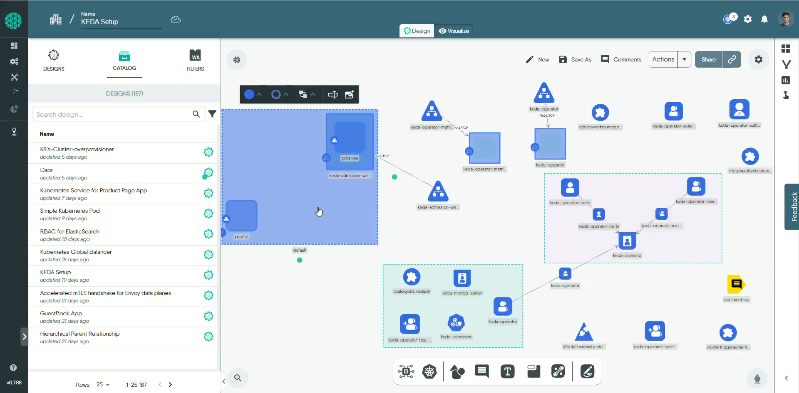

Slide 11
My Contributions

Slide 12
My Contribution
Meshery
✔︎ Implemented Keys and Keychain based authorization which helps Meshery administrators to have more granular access over team & user permissions
✔︎ Created 3 new mesheryctl commands to help users to generate models
✔︎ Created CRUD APIs for construct like views and roles
✔︎ Implemented resource access control to manage permissions of resource
✔︎ Helped in hosting weekly Meshery development meeting

Slide 13
How you can
start?

Slide 14

Join the Layer5 Community!
How do I start?
Jump into our Slack
Review our beginner guides
Get a MeshMate
How do I become a member?
Submit a Community Member Form
Earn a member profile through consistent engagement
Join the Newcomers’ meeting
Where do I find an area to contribute?
See the repositories overview
Explore the “help wanted” issues (~200 currently)
Jump on discussion forum, mailing lists, & meetings
Sustainability
Notes:
Community: Established in US, Africa, India, and Mexico. Forming soon in El Salvador and France.

Slide 15
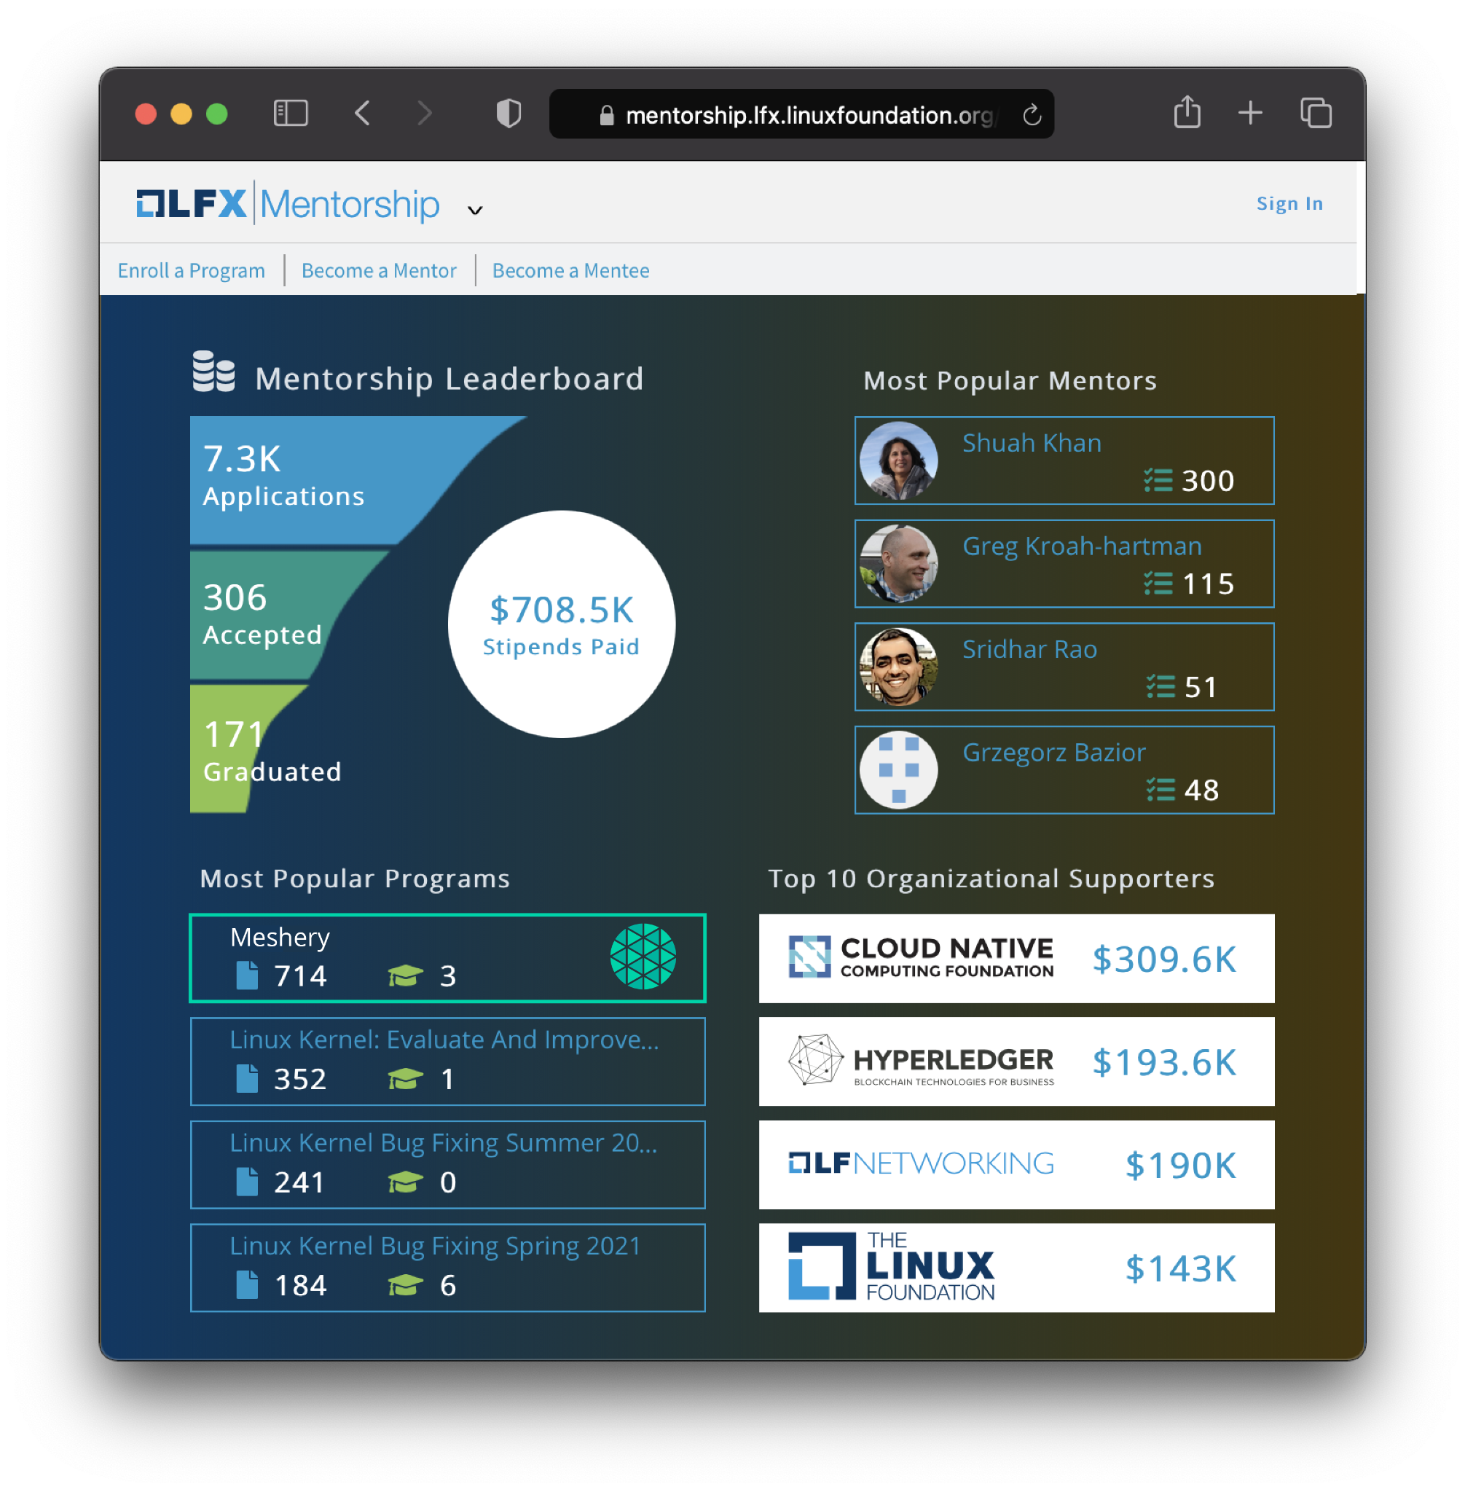
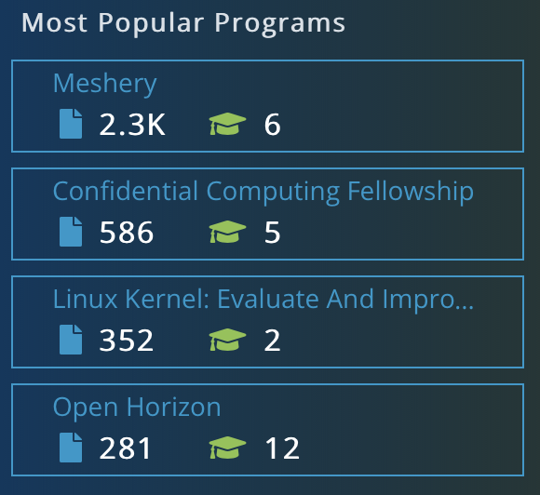








github.com/meshery
@mesheryio
linkedin.com/company/meshery
slack.meshery.io
youtube.com/c/Layer5io
discuss.layer5.io
#1 Most Popular Project
in Linux Foundation Mentorship Program

Slide 16
Thank you

